Slide 1

CHAPTER 8
RELATIONS
Copyright © Cengage Learning. All rights reserved.

Slide 2
SECTION 8.3
Equivalence Relations
Copyright © Cengage Learning. All rights reserved.

Slide 3
The Relation Induced by a Partition

Slide 4
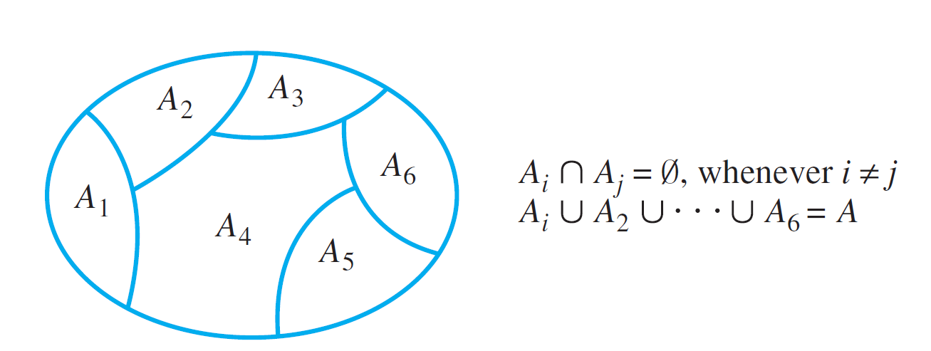
The Relation Induced by a Partition
A partition of a set A is a finite or infinite collection of nonempty, mutually disjoint subsets whose union is A. The diagram of Figure 8.3.1 illustrates a partition of a set A by subsets A₁, A₂, . . . , A₆.
A Partition of a Set
Figure 8.3.1

Slide 5
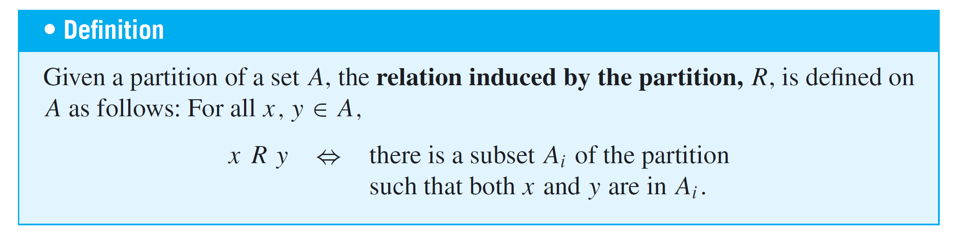
The Relation Induced by a Partition

Slide 6
Example 1 – Relation Induced by a Partition
Let A = {0, 1, 2, 3, 4} and consider the following partition of A:
{0, 3, 4}, {1}, {2}.
Find the relation R induced by this partition.
Solution:
Since {0, 3, 4} is a subset of the partition,
0 R 3 because both 0 and 3 are in {0, 3, 4},
3 R 0 because both 3 and 0 are in {0, 3, 4},

Slide 7
Example 1 – Solution
cont’d
0 R 4 because both 0 and 4 are in {0, 3, 4},
4 R 0 because both 4 and 0 are in {0, 3, 4},
3 R 4 because both 3 and 4 are in {0, 3, 4}, and
4 R 3 because both 4 and 3 are in {0, 3, 4}.
Also, 0 R 0 because both 0 and 0 are in {0, 3, 4}
3 R 3 because both 3 and 3 are in {0, 3, 4}, and
4 R 4 because both 4 and 4 are in {0, 3, 4}.

Slide 8
Example 1 – Solution
cont’d
Since {1} is a subset of the partition,
1 R 1 because both 1 and 1 are in {1},
and since {2} is a subset of the partition,
2 R 2 because both 2 and 2 are in {2}.
Hence
R = {(0, 0), (0, 3), (0, 4), (1, 1), (2, 2), (3, 0), (3, 3), (3, 4),
(4, 0), (4, 3), (4, 4)}.

Slide 9
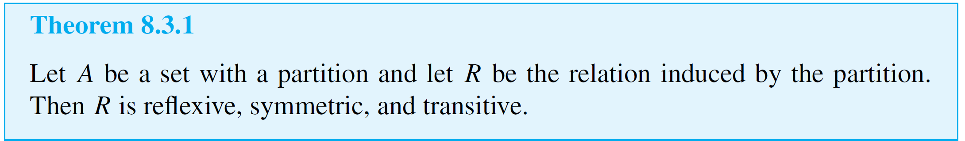
The Relation Induced by a Partition
The fact is that a relation induced by a partition of a set satisfies all three properties: reflexivity, symmetry, and transitivity.

Slide 10
Definition of an Equivalence
Relation

Slide 11
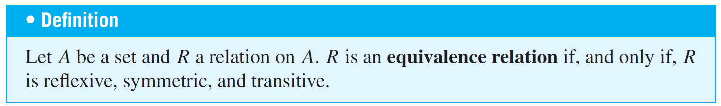
Definition of an Equivalence Relation
A relation on a set that satisfies the three properties of reflexivity, symmetry, and transitivity is called an equivalence relation.
Thus, according to Theorem 8.3.1, the relation induced by a partition is an equivalence relation.

Slide 12
Example 2 – An Equivalence Relation on a Set of Subsets
Let X be the set of all nonempty subsets of {1, 2, 3}. Then
X = {{1}, {2}, {3}, {1, 2}, {1, 3}, {2, 3}, {1, 2, 3}}
Define a relation R on X as follows: For all A and B in X,
A R B ⇔ the least element of A equals the least element of B.
Prove that R is an equivalence relation on X.

Slide 13
Example 2 – Solution
R is reflexive: Suppose A is a nonempty subset of {1, 2, 3}. [We must show that A R A.]
It is true to say that the least element of A equals the least element of A. Thus, by definition of R, A R A.
R is symmetric: Suppose A and B are nonempty subsets of {1, 2, 3} and A R B. [We must show that B R A.]
Since A R B, the least element of A equals the least element of B.
But this implies that the least element of B equals the least element of A, and so, by definition of R, B R A.

Slide 14
Example 2 – Solution
cont’d
R is transitive: Suppose A, B, and C are nonempty subsets of {1, 2, 3}, A R B, and B R C. [We must show that A R C.]
Since A R B, the least element of A equals the least element of B and since B R C, the least element of B equals the least element of C.
Thus the least element of A equals the least element of C, and so, by definition of R, A R C.

Slide 15
Equivalence Classes of an Equivalence Relation

Slide 16
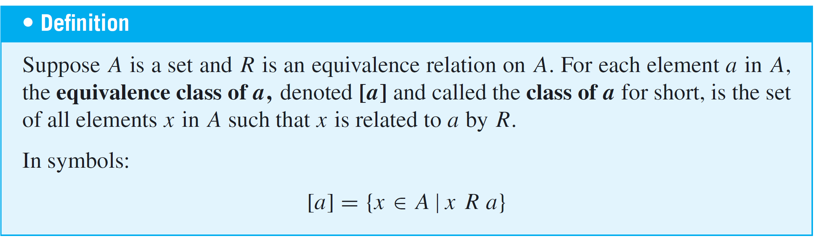
Equivalence Classes of an Equivalence Relation
Suppose there is an equivalence relation on a certain set.
If a is any particular element of the set, then one can ask, “What is the subset of all elements that are related to a?” This subset is called the equivalence class of a.

Slide 17
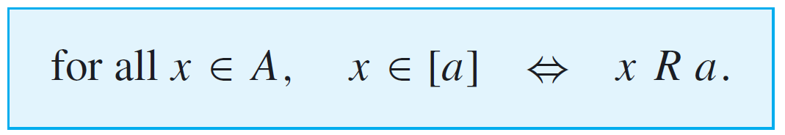
Equivalence Classes of an Equivalence Relation
When several equivalence relations on a set are under discussion, the notation [a]_{R} is often used to denote the equivalence class of a under R.
The procedural version of this definition is

Slide 18
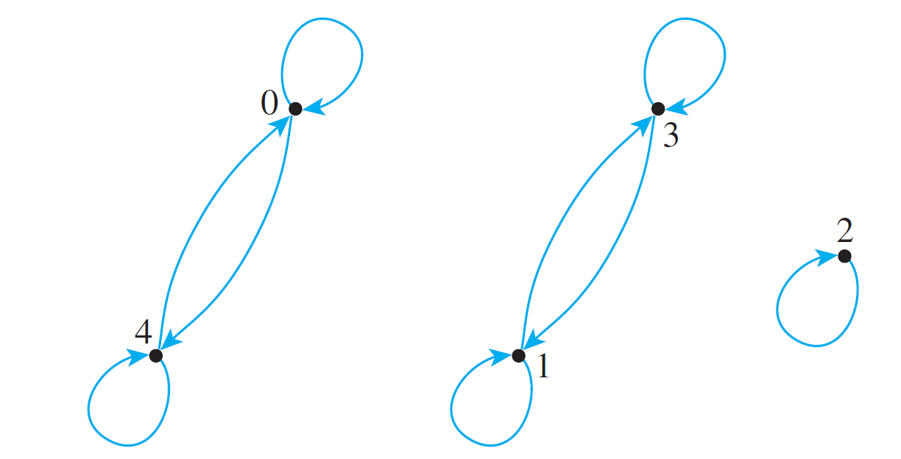
Example 5 – Equivalence Classes of a Relation Given as a set of Ordered Pairs
Let A = {0, 1, 2, 3, 4} and define a relation R on A as follows:
R = {(0, 0), (0, 4), (1, 1), (1, 3), (2, 2), (3, 1), (3, 3), (4, 0), (4, 4)}.
The directed graph for R is as shown below. As can be seen by inspection, R is an equivalence relation on A. Find the distinct equivalence classes of R.

Slide 19
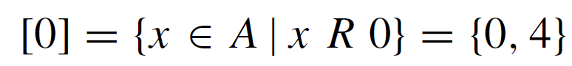



Example 5 – Solution
First find the equivalence class of every element of A.
Note that [0] = [4] and [1] = [3]. Thus the distinct equivalence classes of the relation are
{0, 4}, {1, 3}, and {2}.

Slide 20
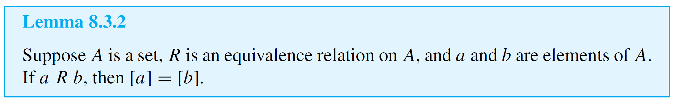
Equivalence Classes of an Equivalence Relation
The first lemma says that if two elements of A are related by an equivalence relation R, then their equivalence classes are the same.
This lemma says that if a certain condition is satisfied, then [a] = [b]. Now [a] and [b] are sets, and two sets are equal if, and only if, each is a subset of the other.

Slide 21
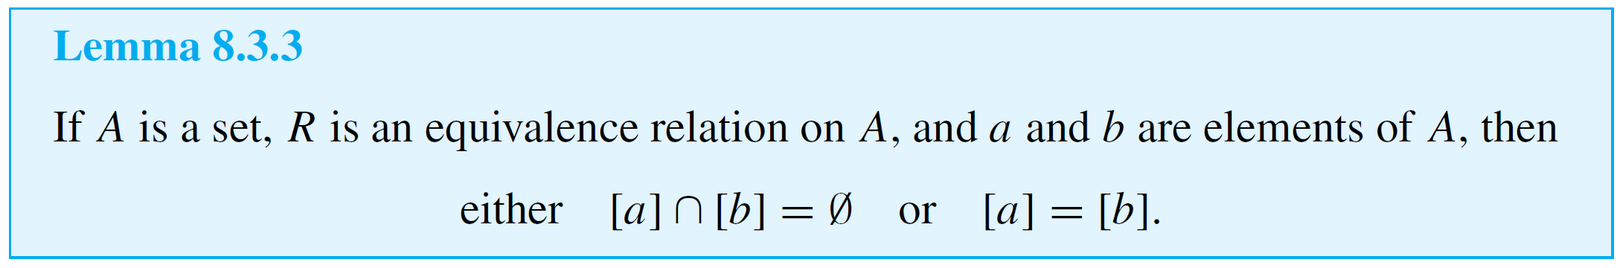
Equivalence Classes of an Equivalence Relation
Hence the proof of the lemma consists of two parts: first, a proof that [a] ⊆ [b] and second, a proof that [b] ⊆ [a].
To show each subset relation, it is necessary to show that every element in the left-hand set is an element of the
right-hand set.
The second lemma says that any two equivalence classes of an equivalence relation are either mutually disjoint or identical.

Slide 22
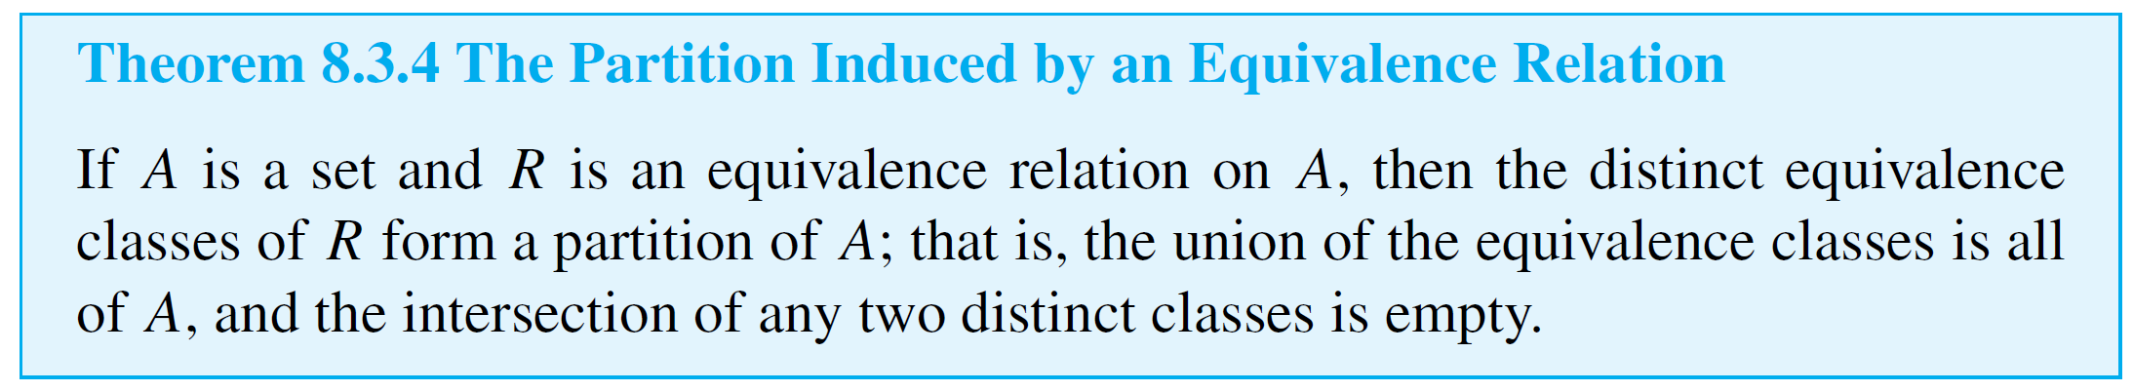
Equivalence Classes of an Equivalence Relation
The statement of Lemma 8.3.3 has the form
if p then (q or r),
where p is the statement “A is a set, R is an equivalence relation on A, and a and b are elements of A,” q is the statement “[a] ∩ [b] = Ø,” and r is the statement “[a] = [b].”

Slide 23
Congruence Modulo n

Slide 24
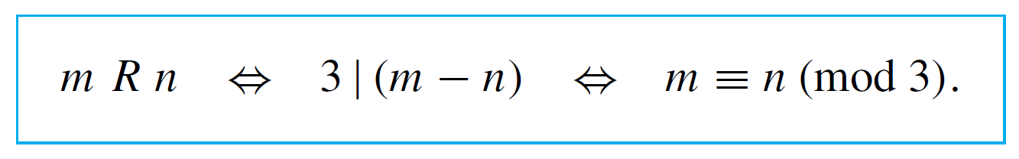


Example 10 – Equivalence Classes of Congruence Modulo 3
Let R be the relation of congruence modulo 3 on the set Z of all integers. That is, for all integers m and n,
Describe the distinct equivalence classes of R.
Solution:
For each integer a,

Slide 25
Example 10 – Solution
cont’d
Therefore,
In particular,

Slide 26
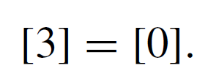
Example 10 – Solution
cont’d
Now since 3 R 0, then by Lemma 8.3.2,
More generally, by the same reasoning,
Similarly,

Slide 27
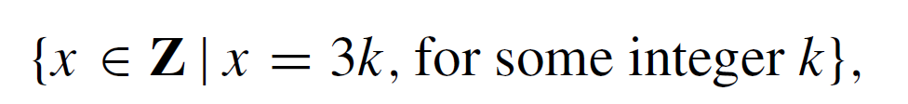
Example 10 – Solution
cont’d
And
Notice that every integer is in class [0], [1], or [2]. Hence the distinct equivalence classes are

Slide 28
Example 10 – Solution
cont’d
In words, the three classes of congruence modulo 3 are (1) the set of all integers that are divisible by 3, (2) the set of all integers that leave a remainder of 1 when divided by 3, and (3) the set of all integers that leave a remainder of 2 when divided by 3.

Slide 29
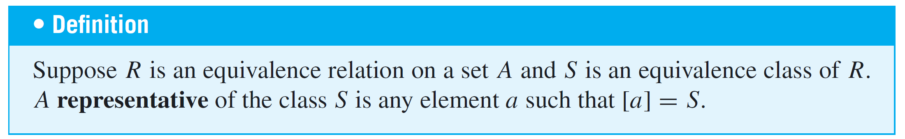
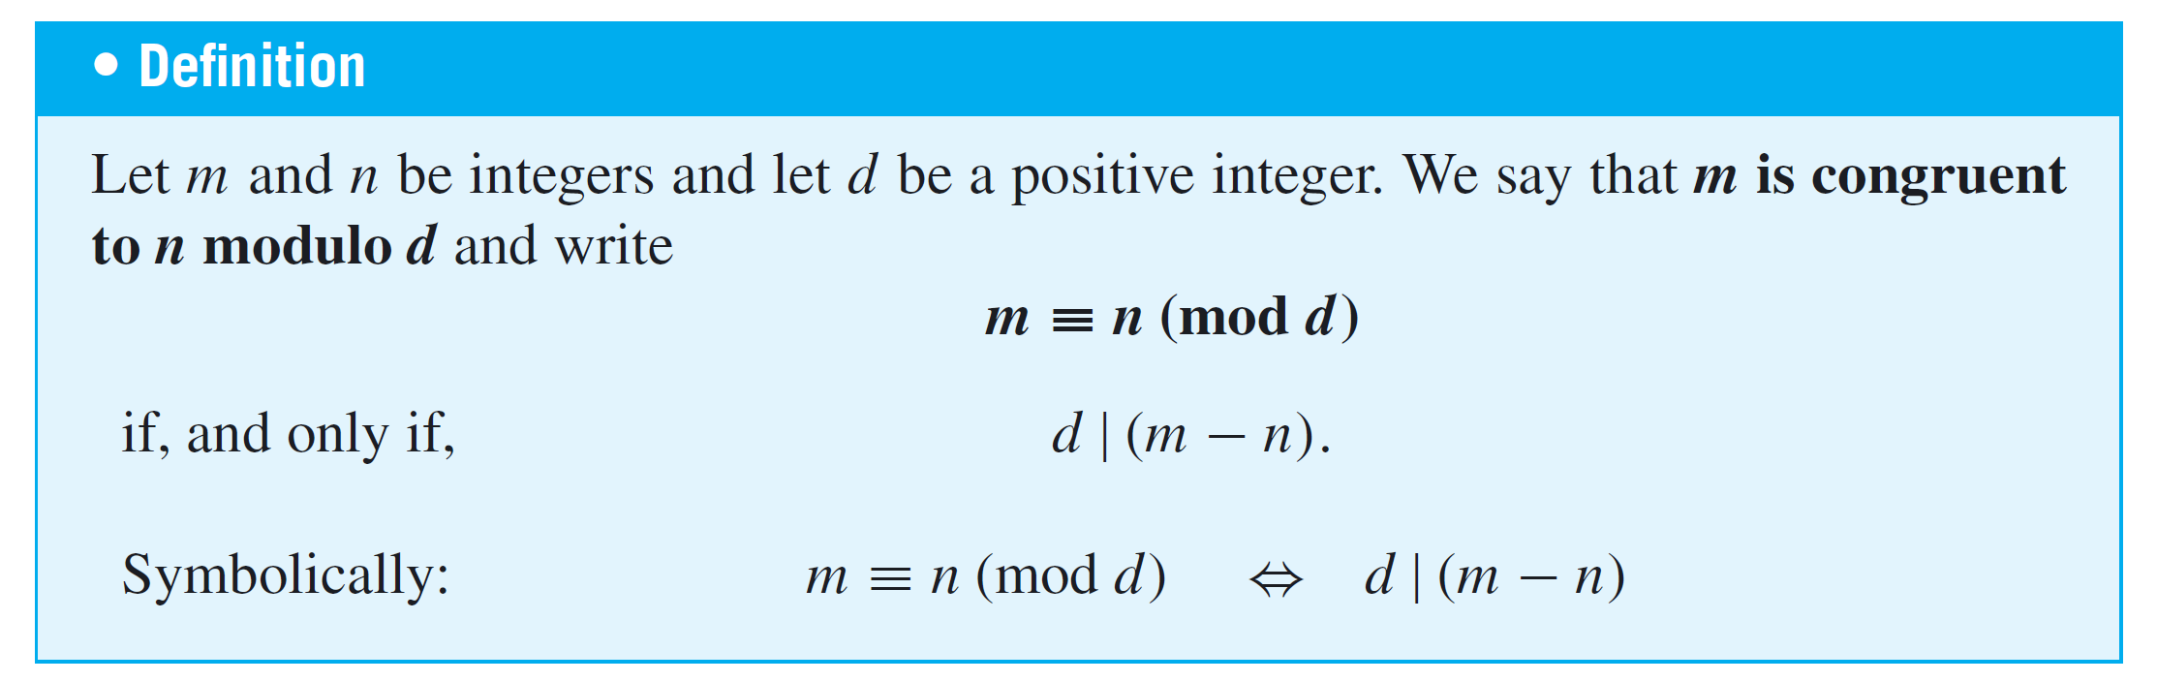
Congruence Modulo n

Slide 30
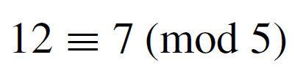




Example 11 – Evaluating Congruences
Determine which of the following congruences are true and which are false.
a. b. c.
Solution:
a. True. 12 – 7 = 5 = 5  1. Hence 5 | (12 – 7), and so
12 ≡ 7 (mod 5).
b. False. 6 – (–8) = 14, and because 14 ≠ 4  k for
any integer k. Consequently,
c. True. 3 – 3 = 0 = 7  0. Hence 7 | (3 – 3), and so 3 ≡ 3
(mod 7).

Slide 31
A Definition for Rational Numbers

Slide 32
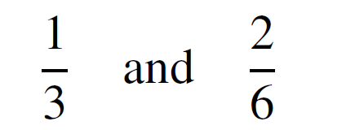
A Definition for Rational Numbers
For a moment, forget what you know about fractional arithmetic and look at the numbers
as symbols. Considered as symbolic expressions, these appear quite different. In fact, if they were written as ordered pairs
(1, 3) and (2, 6)
they would be different.

Slide 33
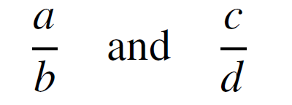
A Definition for Rational Numbers
The fact that we regard them as “the same” is a specific instance of our general agreement to regard any two numbers
as equal provided the cross products are equal: ad = bc. This can be formalized as follows, using the language of equivalence relations.

Slide 34
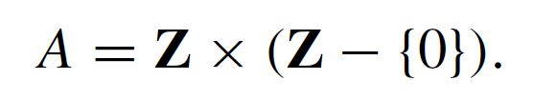
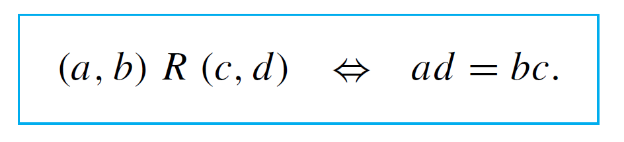
Example 12 – Rational Numbers Are Really Equivalence Classes
Let A be the set of all ordered pairs of integers for which the second element of the pair is nonzero. Symbolically,
Define a relation R on A as follows: For all (a, b), (c, d) ∈ A,
The fact is that R is an equivalence relation.
a. Prove that R is transitive.
b. Describe the distinct equivalence classes of R.

Slide 35

Example 12(a) – Solution
Suppose (a, b), (c, d), and (e, f ) are particular but arbitrarily chosen elements of A such that (a, b) R (c, d ) and
(c, d ) R (e, f ).
[We must show that for all (a, b), (c, d ), (e, f ) ∈ A,
if (a, b) R (c, d ) and (c, d ) R (e, f ), then (a, b) R (e, f ).]
[We must show that (a, b) R (e, f ).] By definition of R,
Since the second elements of all ordered pairs in A are nonzero, b ≠ 0, d ≠ 0, and f ≠ 0.

Slide 36


Example 12(a) – Solution
cont’d
Multiply both sides of equation (1) by f and both sides of equation (2) by b to obtain
Thus
and, since d ≠ 0, it follows from the cancellation law for multiplication that
It follows, by definition of R, that (a, b) R (e, f ) [as was to be shown].

Slide 37
Example 12(b) – Solution
cont’d
There is one equivalence class for each distinct rational number.
Each equivalence class consists of all ordered pairs (a, b) that, if written as fractions a/b, would equal each other.
The reason for this is that the condition for two rational numbers to be equal is the same as the condition for two ordered pairs to be related.

Slide 38
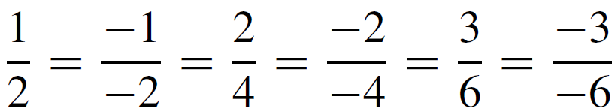
Example 12(b) – Solution
cont’d
For instance, the class of (1, 2) is
since and so forth.

